Slide 1
FeatureCAM 2007 Training
4th Axis Indexing and Wrapping

Slide 2
Agenda
Session 1
Stock Axis & Set up
Single axis setup
Mutiple axis setup
4 axis positioning
Operation Ordering
Tool change position
Session 2
Wrapping
Index about the stock axis
Setup direction
Wrapping patterns
Import solids and extract curves

Slide 3
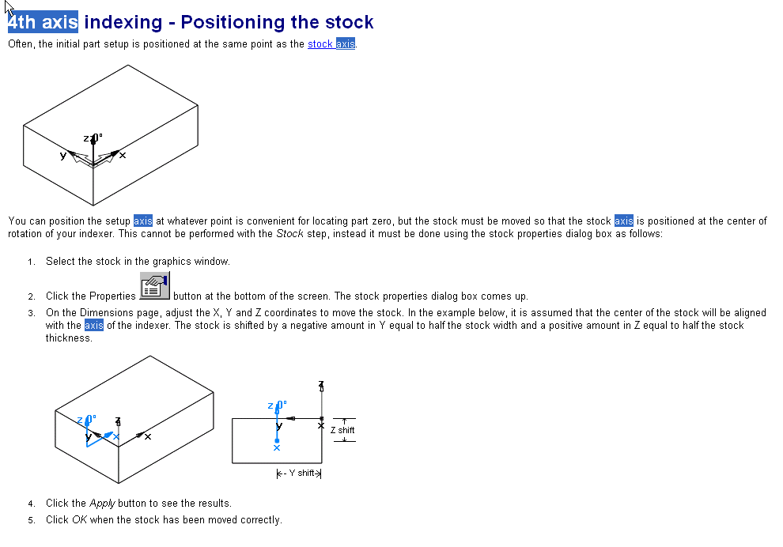
Stock Setup

Slide 4
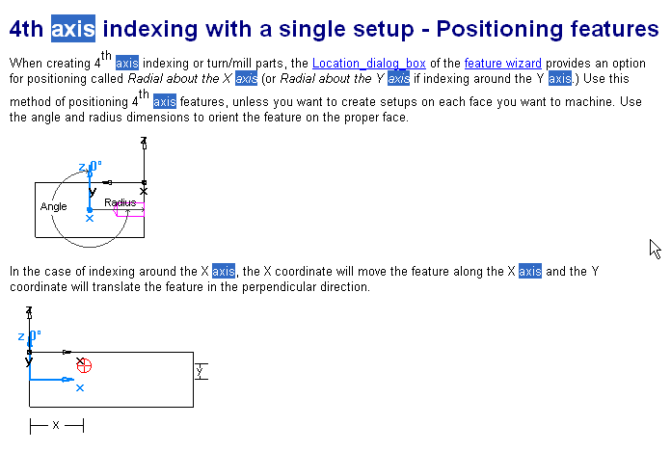
Positioning Features

Slide 5
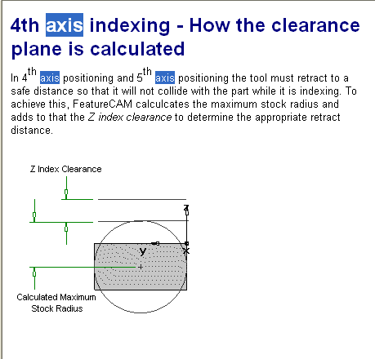
Set a safe retract distance

Slide 6
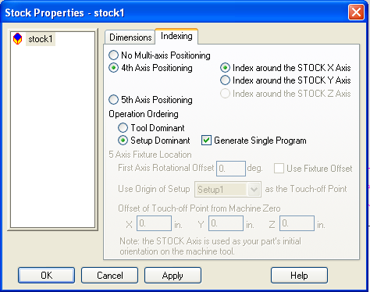
Operation Ordering
Tool dominant
Set up dominant
Generate single program

Slide 7
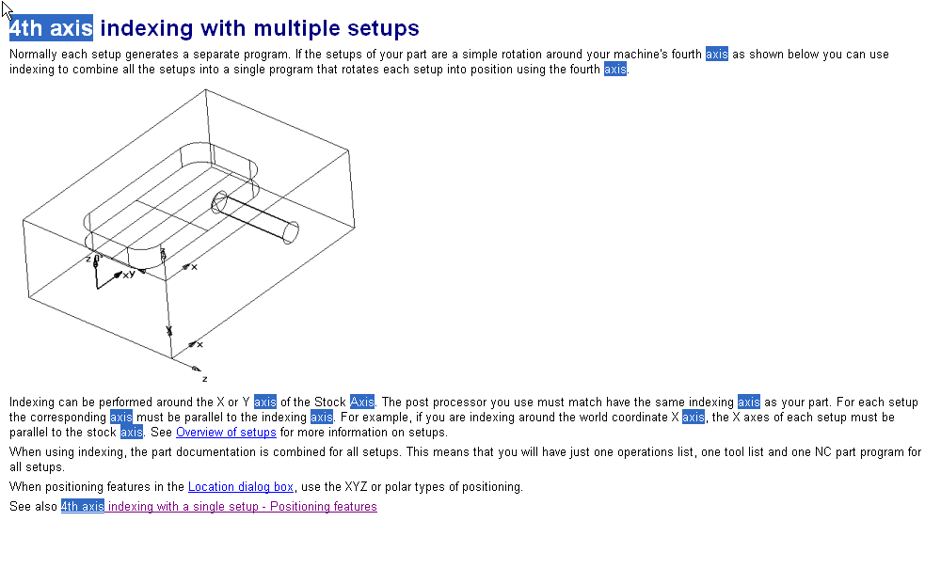

Slide 8
Fourth Axis Overview
Fourth axis overview
You must have a CNC control that supports a fourth axis, and a rotary table or native fourth axis that can be controlled by the CNC machine. The fourth axis can be used in two different ways. It can be used as an indexer, to rotate the part between machining operations so that the machining takes place on different planes of the part. This is called indexing.
The second use of the rotary table is as a continuously moving axis. Rotation occurs during the machining operation and the tool movement is limited to either the X or Y axis and the Z axis. The part itself is rotated to take the place of the axis not used. This feature is called wrapping and is capable of wrapping any feature while the part is rotated

Slide 9
Session 2
Wrapping
Index about the stock axis
Setup direction
Wrapping patterns
Import solids and extract curves

Slide 10
Wrapping Features Around the X or Y Axis
4th axis indexing should be turned on in the indexing tab of the stock
The stock should be round about the Y or X axis
Indexing and wrapping occur about the stock axis. Remember to show the stock axis.
Features need to be made up off of the stock axis. Surface milled features have another set of requirements
Make sure that the feature is radial to the x axis and go back to the dimensions page to check the “wrap feature around the x axis”

Slide 11
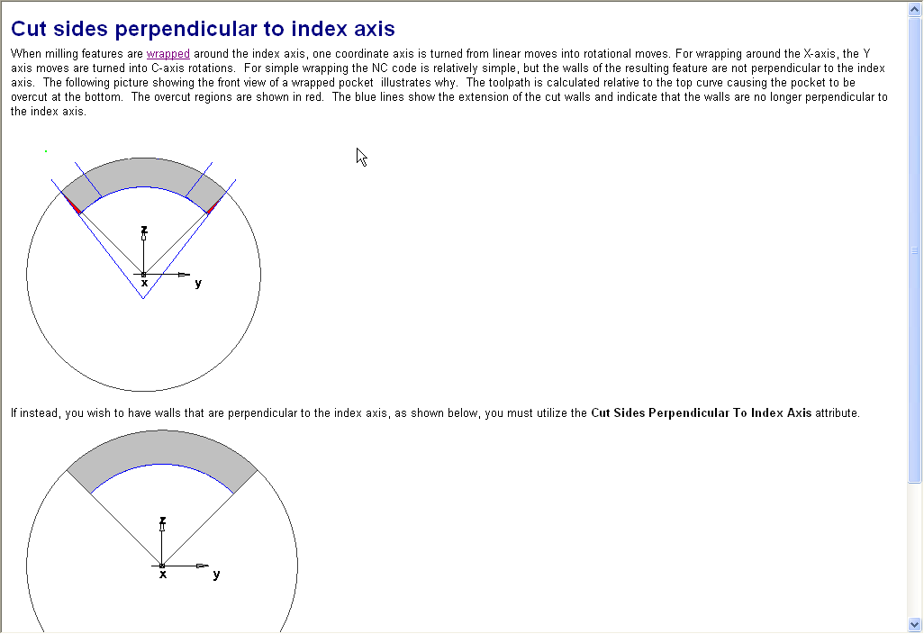

Slide 12
“Wrapping” Around the X wrapping text example.
Open a new milling file (inches), choose round stock shape
Enter dimensions of the stock
length=5, OD=2 , ID=0 & index around X axis
Aluminum->next
4th axis positioning index around the stock x axis->next
Tool dominant->Finish, and OK
Curve wizard->Other Options>Text
In the textbox and the curve name Type in “wrapping”
Pathtype=linear , location=0,0,1 Angle=45
Justification=left, alignment=1,0 scaling=1,1 spacing=0
Font=Machine tool Grenadine, font style=regular, size=72
OK then preview then OK

Slide 13
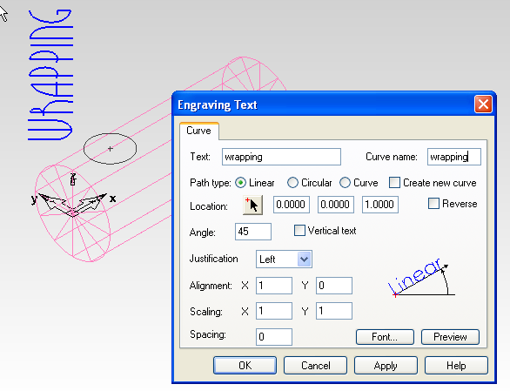
Should look like this

Slide 14
Wrapping text example continued.
Go to the new feature wizard and choose groove form curve.
Select the curve “wrapping” click next, next
Input .0625 for the width and depth, check the simple and face options then Finish.
Bring Up the groove properties.
In the Dimensions Tab check the “wrap around X axis” option, then Apply and OK.
Run your 3D simulation.
Save the file as “wrapping.fm”

Slide 15
Wrapping Patterns
Hole in a radial pattern
Specify the tool change location

Slide 16
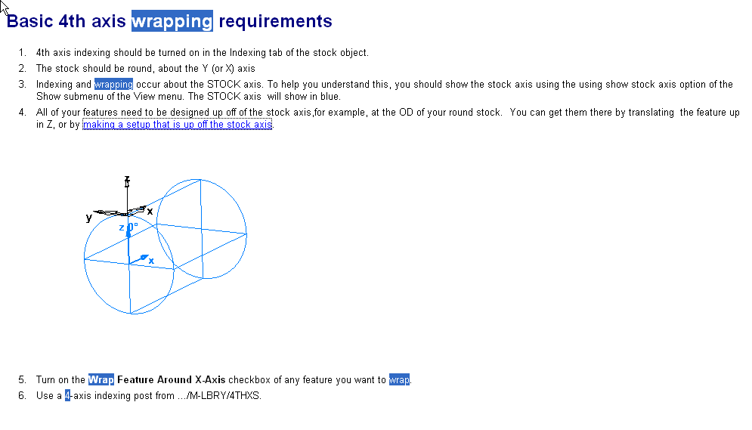

Slide 17
Open Curves
When creating wrapped side features Total Stock will have to be specified
Or a stock curve will need to be created Open example: index2Bsides.fm

